Slide 1

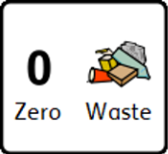


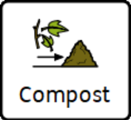




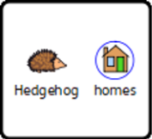

Nature Ninja student record sheet Autumn Activities
Nature Ninja ____________________________________
Autumn Activity Record. Level ____________________

Slide 2





Nature Ninja ____________________________________
has achieved the following NHS 5 steps to wellbeing

Slide 3
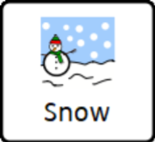
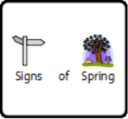
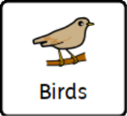
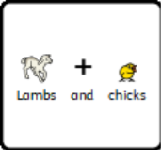

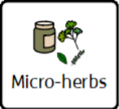
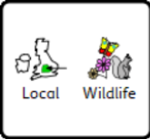


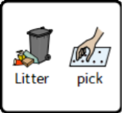
Nature Ninja student spring activity record
Nature Ninja ____________________________________
Spring Activity Record. Level ______________________

Slide 4
Nature Ninja ____________________________________
has achieved the following NHS 5 steps to wellbeing

Slide 5




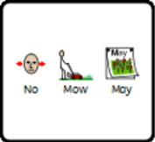




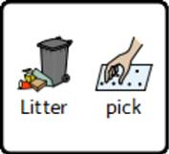
Nature Ninja Student summer activity record sheet
Nature Ninja ____________________________________
Summer Activity Record. Level ____________________

Slide 6
Nature Ninja ____________________________________
has achieved the following NHS 5 steps to wellbeing

