Slide 1

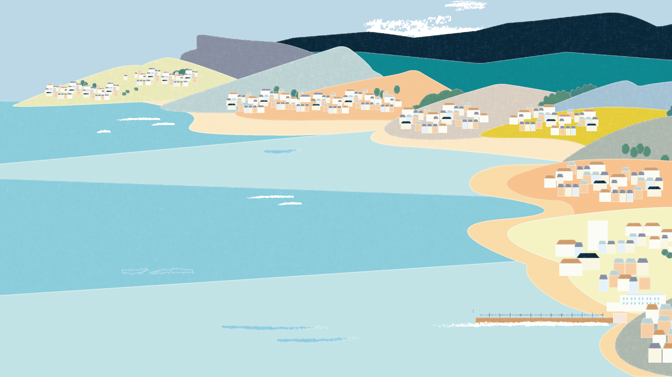
MBC Conference
Education and Green Skills Deep Dive – Dr Beth Garrett and Maggie Cawthorn

Slide 2

Aims for the session
15 minutes: Introduction to Education, MBC principles, including head, heart and hands and how to embed these
5 minutes: Discussion around current practices – identify what you are already doing and share with others!
10 minutes: Understanding the Green Passport as a way of linking environmental education and green careers
5 minutes: Discussion around current green careers provision
10 minutes: Action planning with support!

Slide 3
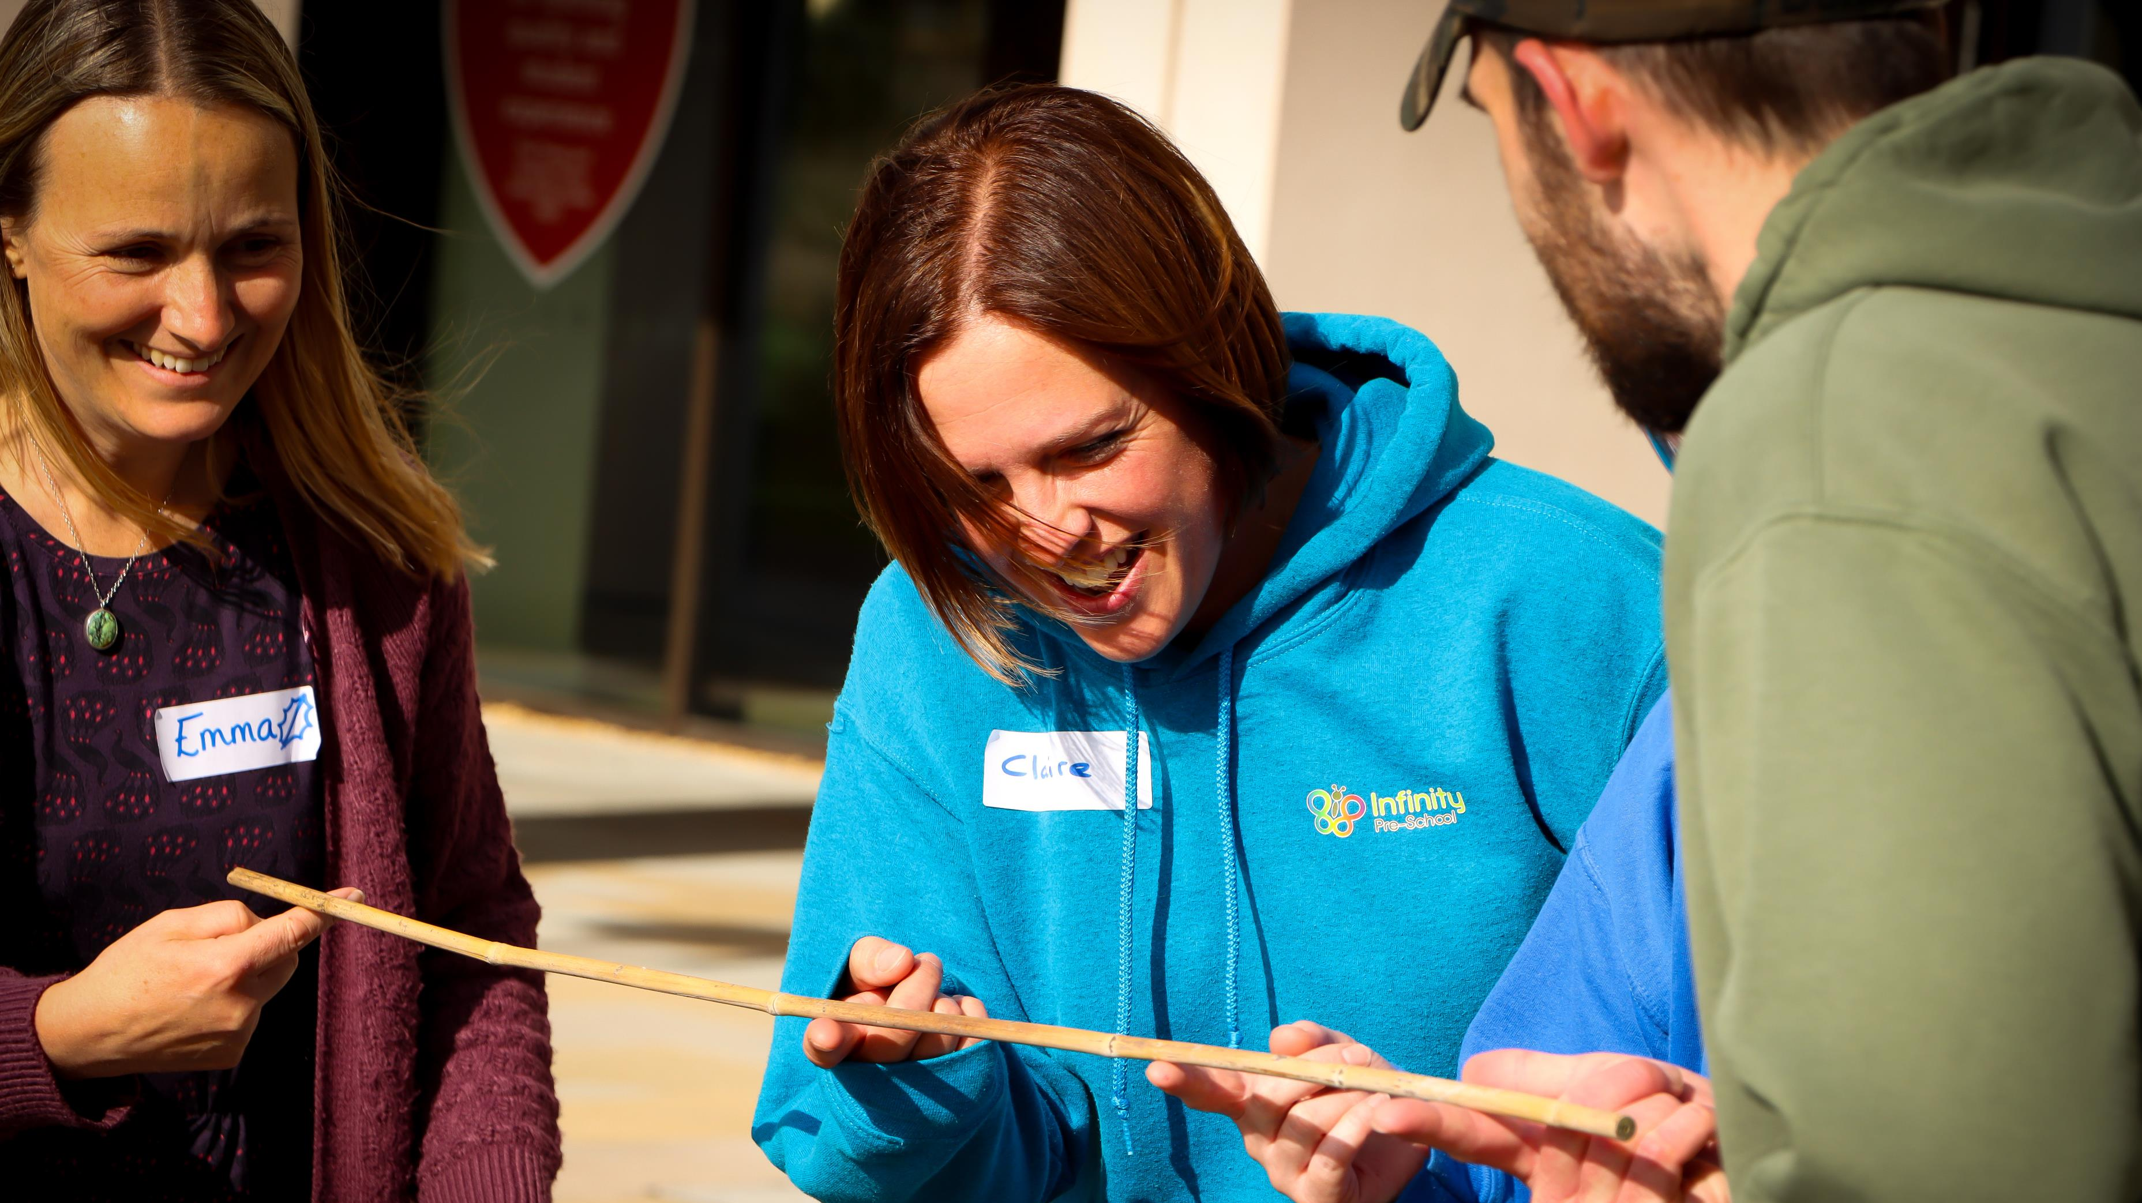
This is an educator-led movement

Slide 4
Educators empowering young people to become the change-makers our planet needs

Slide 5
Weaving sustainability & place into everyday practice

Slide 6
Outcomes to date
250+ educators signed up to movement.
90 partner schools, colleges and universities
33 educator designed and delivered projects, including Eden Bear who has visited 100+ nurseries and EYFS settings.
Six working groups, co-creating activities, campaigns and resources for every educational stage. Covering Early Years, Primary, Secondary, Further Education, SEND and Alternative Provision, with a combined membership of over 60 educators.
16 age-specific subject resource packs co-designed by 40+ teachers and LU academics, linking place and sustainability to National Curriculum objectives. These are supported by a further 130+ resources created to help educators in translating this work into the classroom.
Three annual conferences, with 200+ educators gathering for knowledge exchange, network development and training. 2025 conference in collaboration with Let’s Go Zero, National Education Nature Park and Climate Ambassadors.
Notes:
MBC: Resources for our Bay: Place, Sustainability, Environment and Hope | openlearning

Slide 7

Aims and Approach
Strength in the collective
Community governance representative of education broadly
Celebrating Place
Emphasises the unique characteristics of the region, including people, natural environment, history, and future, making sustainability education relevant.
Building Connections
We aim to support connections between members of our community so that everyone knows where to go for support.
Community-Driven
An educator-led movement comprised of teachers, early years practitioners, researchers and community leaders.
Sustainability & Climate Action through
‘Head, Heart and Hands’
Equips students with knowledge (head), values (heart) and skills (hands) needed to build a sustainable future.
Co-design Model
Educators and academics collaborate, creating evidence-informed, engaging, place-based resources.

Slide 8
Our key principles
We need more than just facts and information about the environment and sustainability – we need increased awareness, critical thinkers, problem-solvers and decision makers.
Education prepares children and young people to be responsible citizens, allowing them to face climate change with a strong set of values which they can defend and can guide their decisions.
Through Head, Heart, Hands, we can develop knowledge, skills, behaviours, attitudes and values to help them cope with a changing world.
This needs to run across all subjects and throughout their whole education, from their first experiences of awe and wonder as a child through to engaging with challenging and relevant problems as adolescents.
Through taking action, we can challenge eco-anxiety and move towards personal and systemic transformation.

Slide 9

Head, Heart and Hands
Developing knowledge linked to NC subjects, place and the environment
Developing positive values, moral, ethics, socio-emotional responses and a love for the Bay
Developing critical and creative skills and the ability to think about complex problems

Slide 10
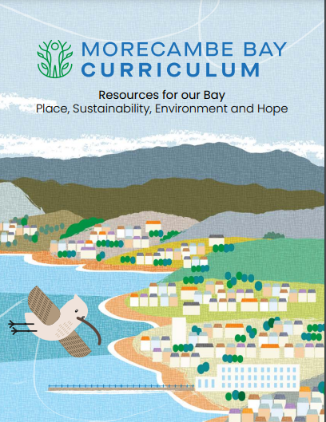
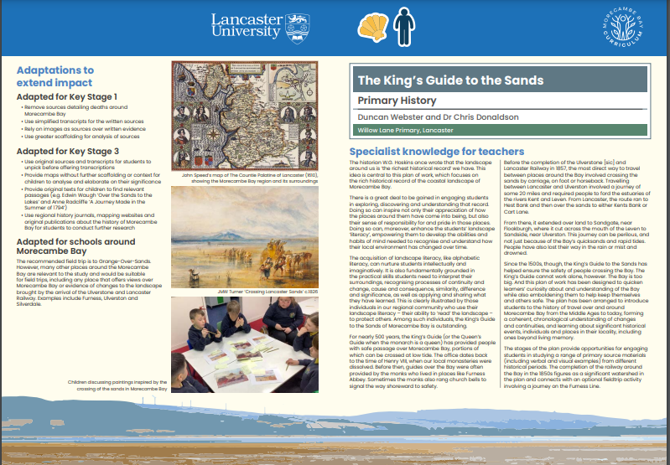
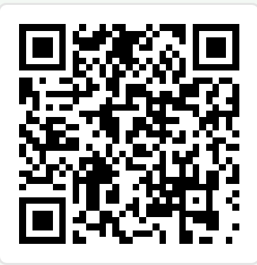
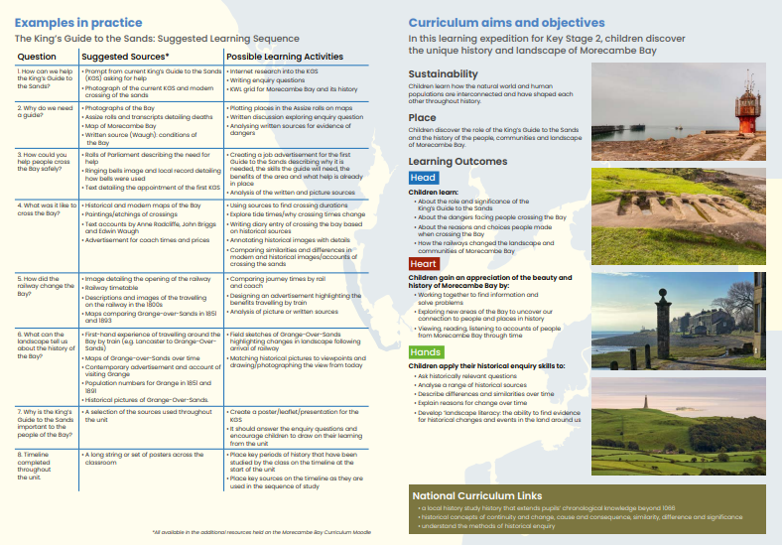
A publication for everyone

Slide 11
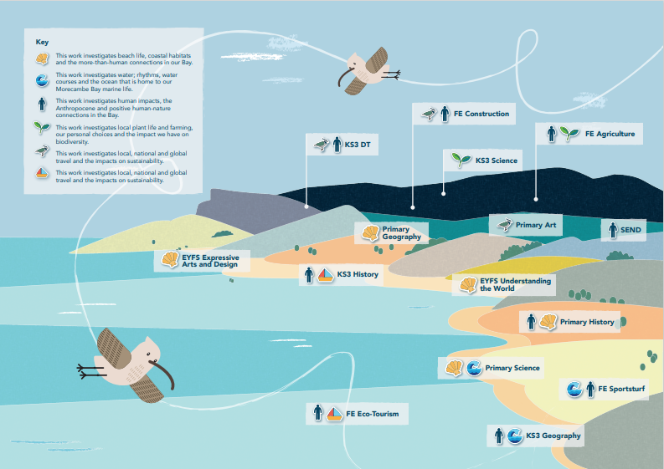
Resources for each subject area
Specialist subject knowledge for teachers based on the academic’s research
Links to National Curriculum expectations
How the resource draws upon Head, Heart and Hands pedagogical framework
How the resource could be adapted to other contexts
Links to key themes
Example lesson plans and resources for teachers to use with many extensions and detailed plans online

Slide 12
Our Resources
Early Years Foundation Stage | Resources
Understanding the world | Little Bay Explorers: Understanding the world through curiosity and wonder
Expressive Arts and Design | Near and far, high and tiny: Looking and listening in the Bay
Primary KS1 and KS2 | Resources
Art and Design | Birds of the Bay: Teaching Science through Art
Geography | A Day at the Beach: Present and Future
History | The King’s Guide to the Sands
Science | Rhythms of the Bay: Living things and their habitats
SEND/Inclusion | How to adapt the resources to the needs of all pupils
Notes:
Outdoor learning
Arts based methods
Engaging with historical sources

Slide 13
Secondary | Resources
Design Technology | Flight investigations: Curlews vs the Airbus Air380-300
History | What have colonialism and empire got to do with sustainability and development?
Geography | Energy generation or energy conservation?
Science | Making plants pop: Weaving knowledge of local plants into your teaching
PSHE | Wellbeing and blue spaces: Using creative methods to explore connections and build resilience
Further Education | Resources
Agriculture | Understanding the impact of food choices: Carbon and water footprints
Construction | Sustainable construction and biomimicry
Eco-tourism | A comparative study of local, national and global locations
Sports Turf | Flood risk in sports turf: Climate change adaptation and mitigation
Notes:
Investigations
Debates
Research tasks for student led learning
Problem-based learning (whereby there is a real life problem)
Reflective tasks

Slide 14
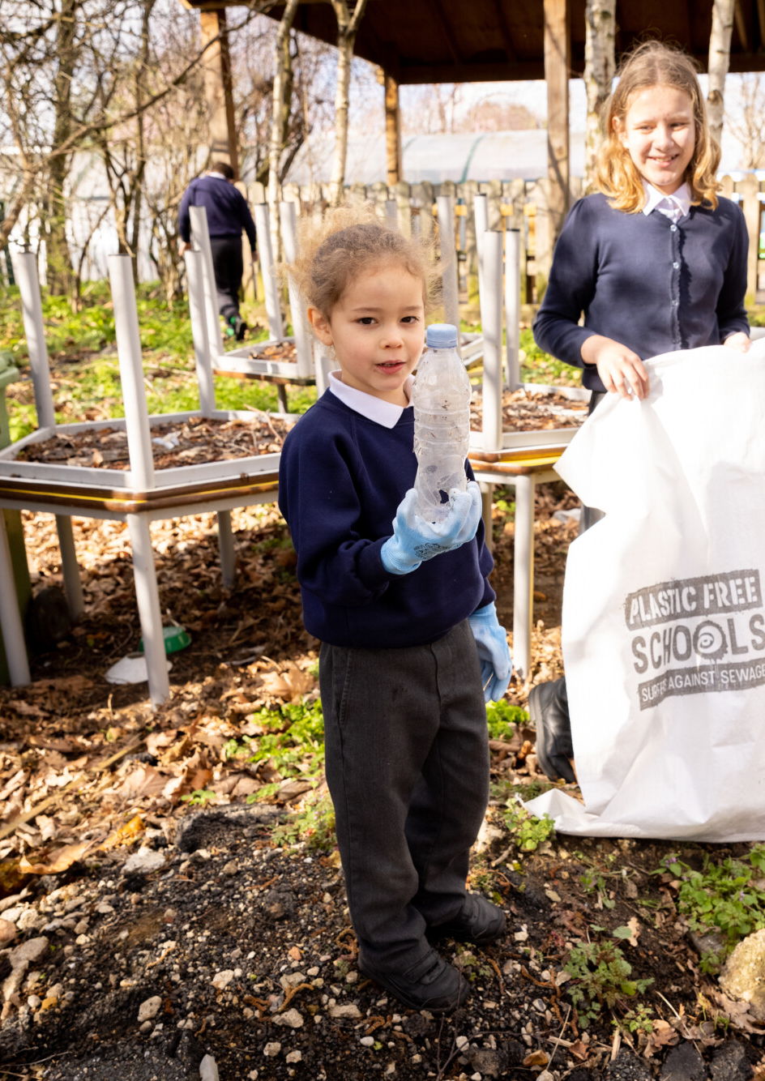

DfE Support: Initial steps
Assess the current state of climate education in your setting: Understand how aware your learners are about sustainability, and what you're already covering in teaching and learning. This will help you to target areas for development.
Encourage outdoor learning: Think about how to use the outdoor space you have - however small - to promote climate and sustainability awareness and increase wellbeing.
Tackle steps to address climate anxiety: Young people are among those most impacted by climate anxiety, and it can have a negative effect on learning and development. It can also affect your staff and other members of your community. Start to plan how your setting will tackle this issue.
Notes:
https://www.sustainabilitysupportforeducation.org.uk/overview-of-the-sustainability-journey

Slide 15
Assessing your current provision
Complete a curriculum audit and identify where there is potential to embed environmental learning
Survey environmental awareness amongst learners and staff
Use your sustainability initiatives as learning opportunities

Slide 16
Discussion
In what parts of your setting's curriculum do pupils currently learn about nature, climate change and the importance of sustainability?
How confident are you and your staff in delivering climate change and sustainability material? Do you have access to high quality materials to support with this?

Slide 17

Green Careers
What are they?

Slide 18
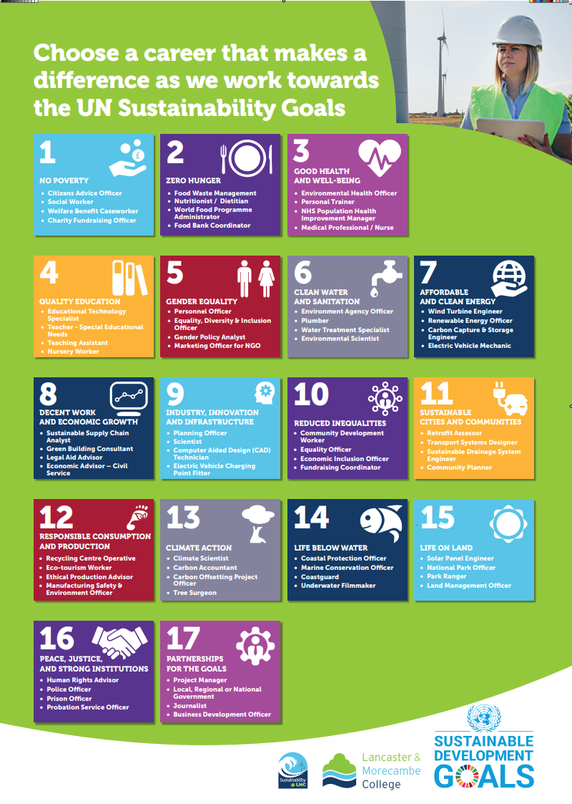
Drivers of career choice – careers with purpose

Slide 19
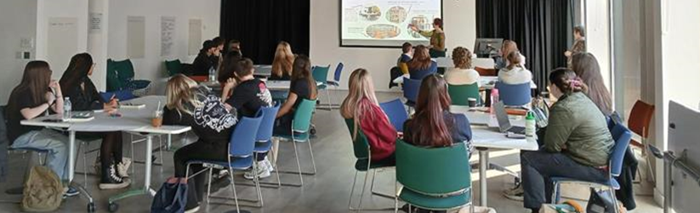
MBC Green Passport: pedagogy
•EE cannot be authentically delivered within as a transmissive, predominantly knowledge-based curriculum (Sterling and Orr, 2001; Huckle and Wals,2015; Kahn, 2010; Jickling, 2017).
Transformational learning theory (Mezirow, Freire, Sterling, Wals, Jickling) and social constructivism (Vygotksy)
•Learners are active in their learning
Value what learners already bring to their learning:
•relating to environmental issues in learners’ own communities, encouraging them to want to live sustainably and take action for their locality
•critical reflection, experiential learning, and student-led real-world problem-solving projects and case-studies, to aim to change the perspectives of the students

Slide 20
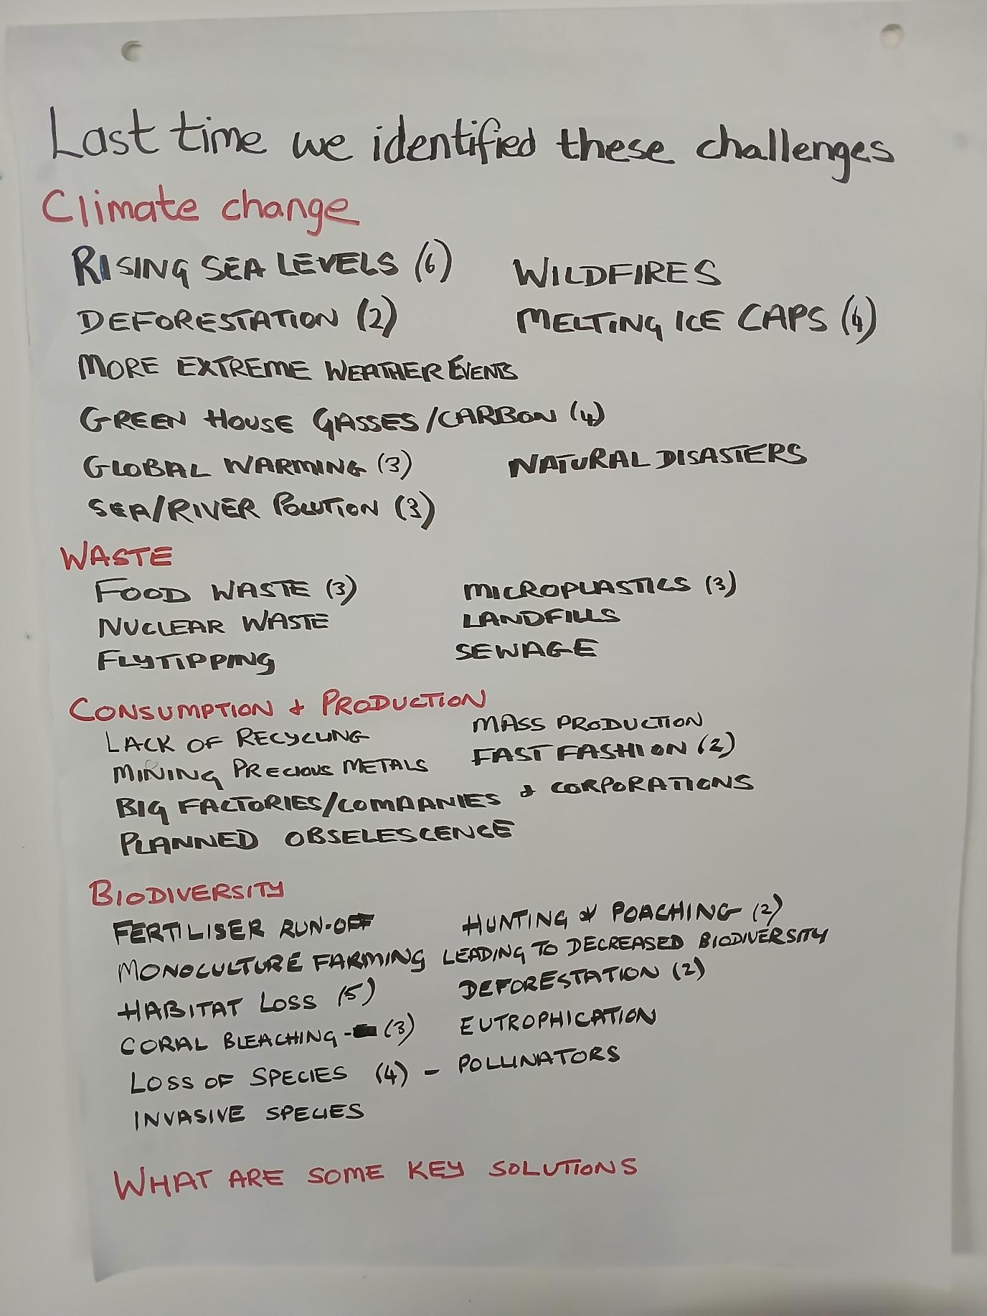
MBC Green Passport: assessment
A key part of the learning process rather than a checking process
Students choose their area of interest – identify challenges, offer solutions, finally reflect on their own roles and potential futures
In this they were engaging in critical analysis and developing their own specialisms

Slide 21
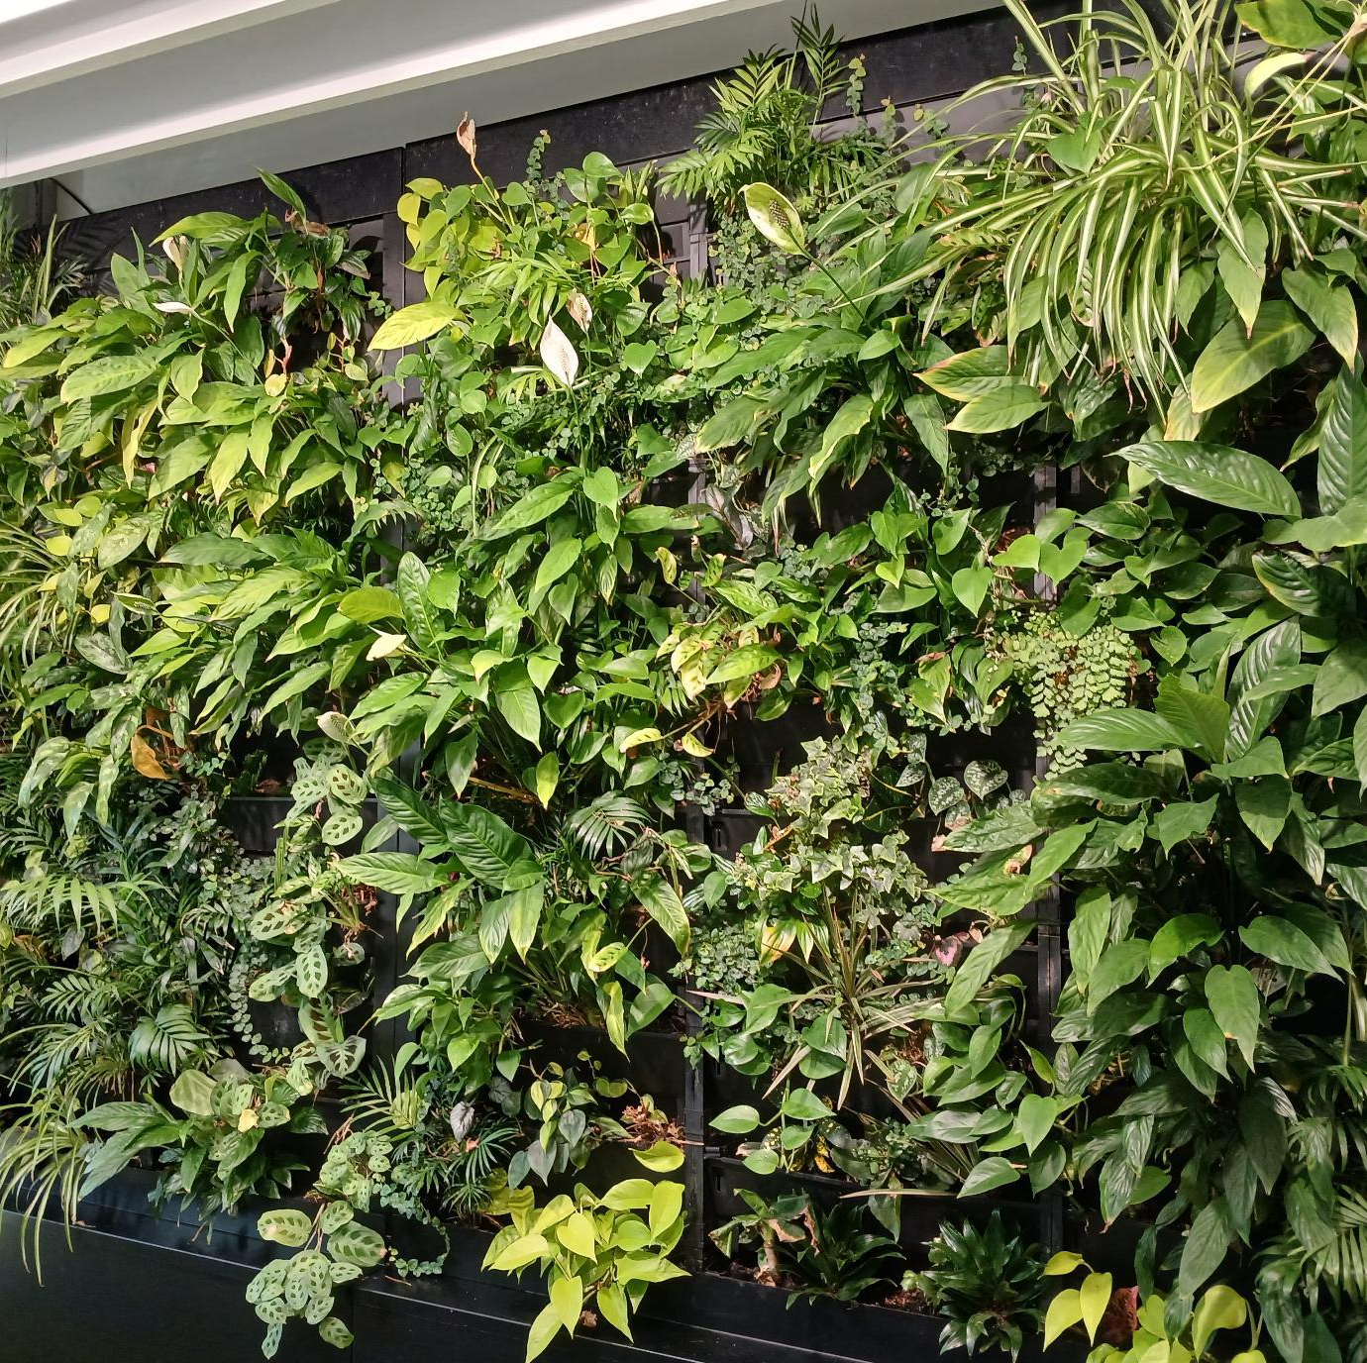
MBC Green Passport: some of the topics
Biodiversity on roundabouts in Skelmersdale
Environmental impact of the new Lancaster hospital
Environmental impact of Morecambe FC stadium – a scheme for encouraging car-sharing for away fans
Reducing carbon emissions on long haul flights
Sustainability and art materials
Green walls in construction

Slide 22
Discussion
Are pupils made aware of the likely future career opportunities which exist in the green economy?
Do they know how different vocational areas are likely to be impacted by climate change in the future and how they can use their own learning to make a positive difference?

Slide 23
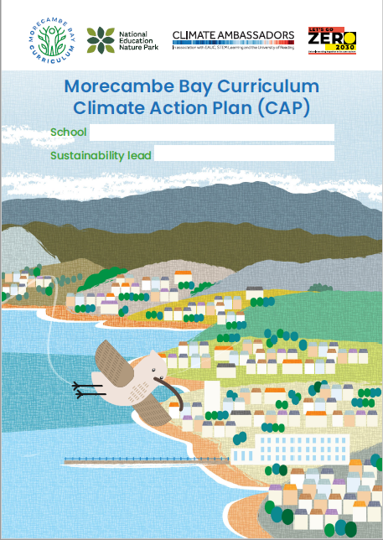
Action Planning: Potential first steps
Sign up to become a member of MBC and gain access to our resources.
Complete a curriculum audit to identify areas of good practice and gaps.
Survey pupils and staff to gain a baseline of their understanding – this could be repeated in the future to demonstrate impact of initiatives.
Set up or develop your eco-club and extra-curricular opportunities.
Embed opportunities to engage with sustainability issues across a broader range of subject areas – think creatively!
Engage a climate ambassador or local business representative to discuss the green elements of their career.
Connect wider work on the other pillars to education and learning – look for co-benefits!

Slide 24
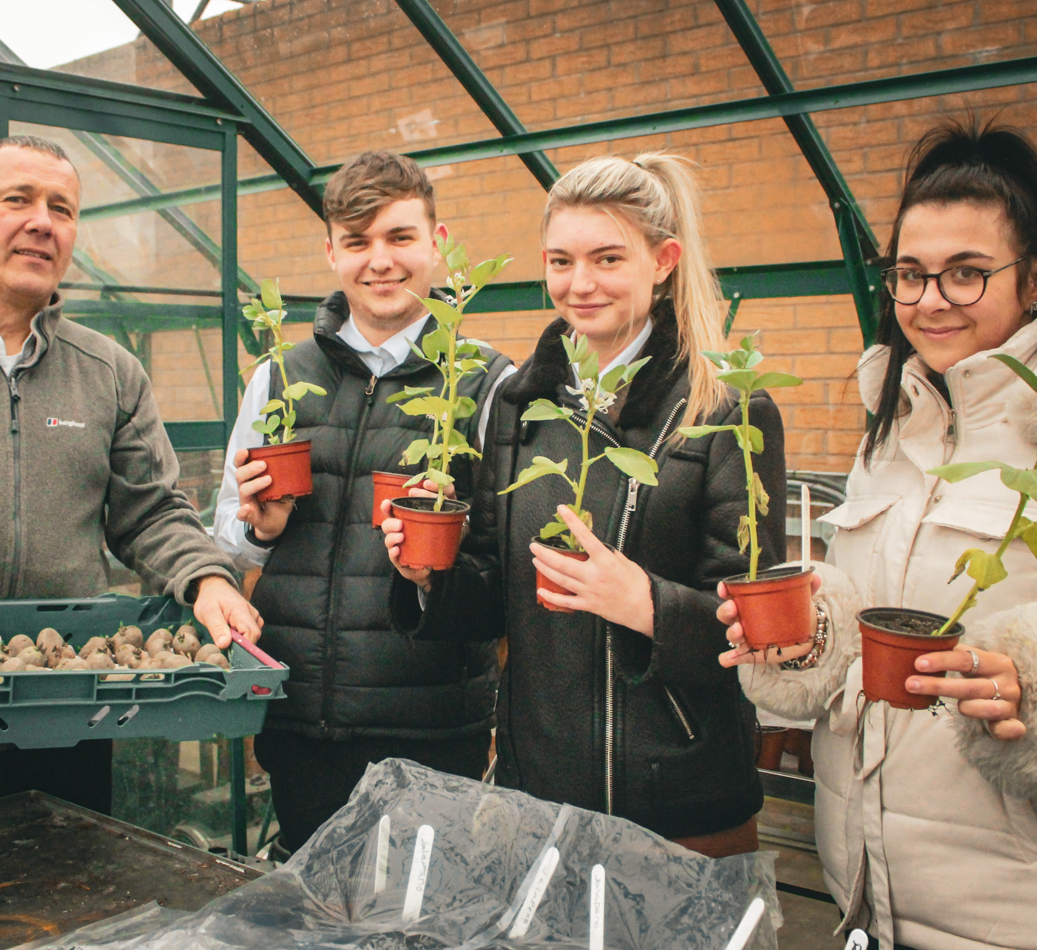
Links to the other pillars – how can education support these
Auditing the school grounds/buildings and devising green solutions and adaptations can build skill development e.g. measuring, mapping, costing, designing, planting and nurturing
Art can be used to highlight issues and raise awareness by sharing key messages around the school
Exploration of biodiversity on school grounds has lots of links to the curriculum and can support pupils in getting a real-life experience/ opportunity without having to organise an educational visit
Designing solutions to real-life problems and then collecting data to measure the impact of these can link to D&T, maths and science objectives
Student voice in discussions with school leaders can link to democratic participation, leadership and communication skills

