Slide 1




MBC Skills Portfolio: Facilitators’ guide
MBC Skills Portfolio
Facilitators’ Guide

Slide 2
Explanations about MBC Skills portfolio and MBC pedagogy
Morecambe Bay Curriculum takes an holistic approach to learning using the Head, Heart, Hands pedagogy:
​
Head; knowledge, understanding, cognition
(mental process of acquiring knowledge and understanding through thought, ​experience and senses) and critical thinking analysing information, evaluating evidence, reasoning, informed decision making).​
What is the MBC Skills Portfolio?
This resource was co-designed by the
Morecambe Bay Curriculum
Alternative Provision working group of AP specialist educators.
The MBC Skills Portfolio is a two-level award designed for KS3 and KS4 students at schools and Alternative Provision centres. ​
It aims to develop essential skills for
post-16 education and employment
through practical, place-based,
outdoor learning activities,
following the head, heart, hands pedagogy.​
Heart: values, care, connection and compassion.
Hands: application, actions, skills and participation​

Slide 3

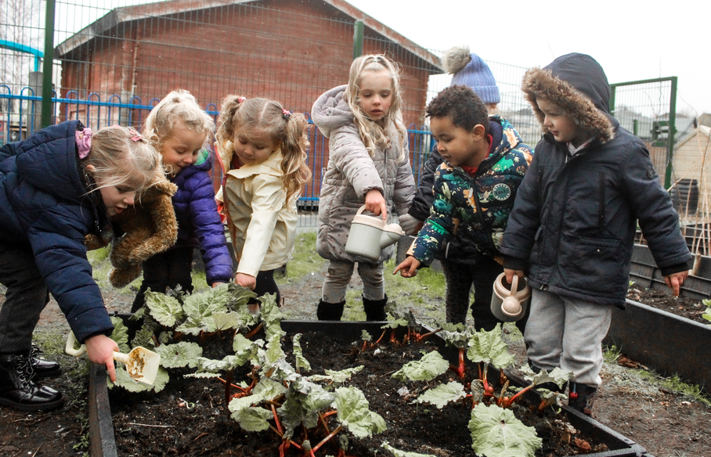
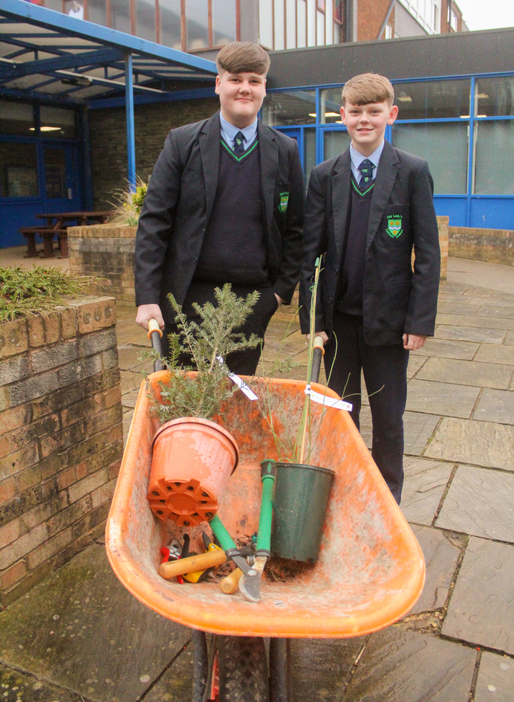
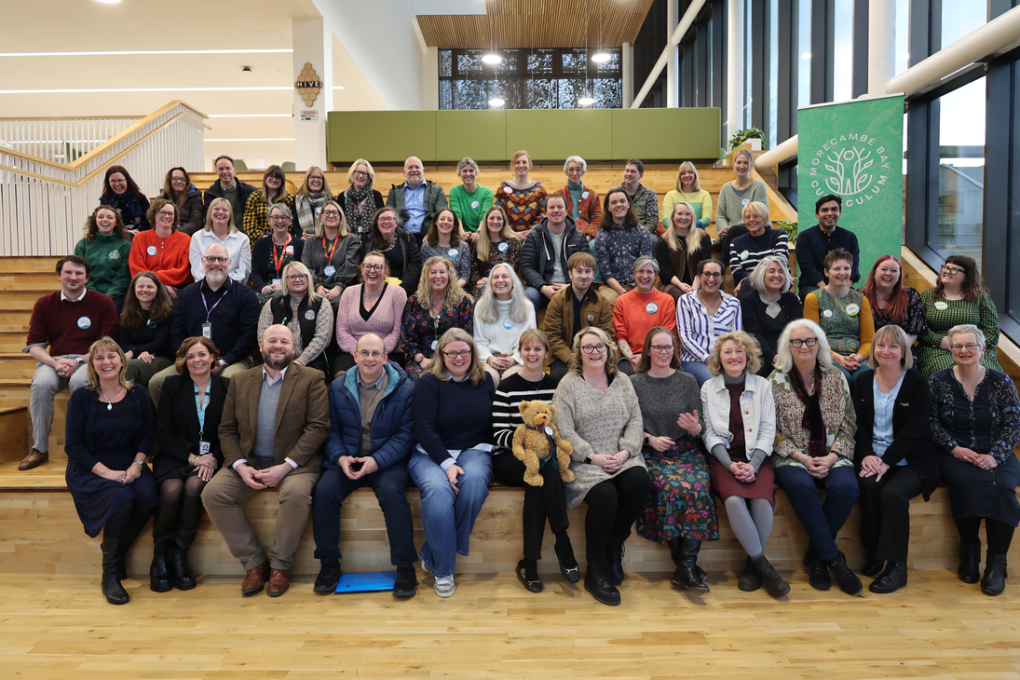
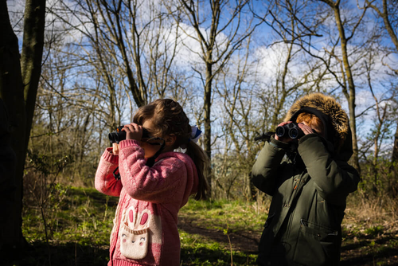
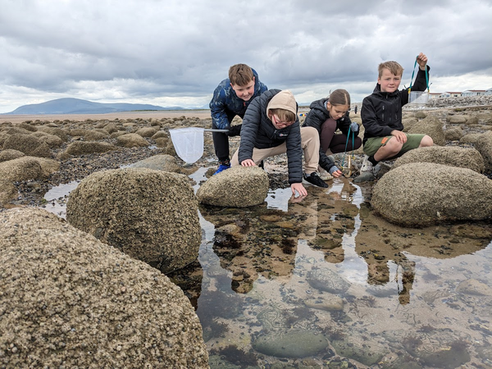
What is MBC? How to join
Join the MBC Community
https://www.lancaster.ac.uk/morecambe-bay-curriculum/join-us/
This is a FREE membership, open to every teacher and education facillitator working around Morecambe Bay.
Our catchment includes; Barrow and Furness, Westmorland and Lonsdale, Morecambe and Lunesdale, Lancaster and Fleetwood, Wyre and Preston North.
MBC is an educator-led movement and a
cross-sector partnership supported by schools around the Bay, Lancaster University, Lancaster and Morecambe College, and University of Cumbria.
Together, through a community-curated, place-based approach to learning about sustainability, we can transform education by empowering young people to become the change-makers and innovators our planet needs.

Slide 4
How to use the MBC Skills Portfolio
How to Use the MBC Skills Portfolio
  Become a member of the MBC.
https://www.lancaster.ac.uk/morecambe-bay-curriculum/join-us/
2. Access the MBC Skills Portfolio resources
from the Morecambe Bay Curriculum Alternative Provision resource pages.
3. Facilitate the activities
Set up either a digital or paper-based copy of the portfolio
for each participating student. Provide it in the
best format and size appropriate for your students.
The chosen format must enable students to record their
progress, add evidence and reflections, read facilitators’
feedback and assessment.
4. Organise and run the activities
which align with the portfolio stamps. They don’t need to happen on the beach, they can be adapted to run in different habitats around the Bay.
6. Achieving the Awards
The MBC Skills Portfolio offers 2 Award levels;
Level 1 Award: To achieve this, students must successfully earn 6 stamps from any of the 6 badges.
Level 2 Award: To achieve this higher award, they must earn an additional 6 Level 2 activities stamps, supported by the required evidence.
5.Verify the Portfolio Evidence
staff are responsible for observing, verifying and potentially logging student evidence for collecting portfolio stamps

Slide 5
Students’ guidance for using the MBC Skills Portfolio
For Students
Understand the pedagogy: The activities are designed to engage the Head (knowledge and understanding), Heart (reflection) and Hands (practical activities).
Participate in activities : based on your provision, we identify a group as 2 or more people (1 can be an adult). Engage in the designated activities, working towards earning stamps in one of more of the following badges;
•Bay Warden
•Bay Navigator
•Coastal Crafter
•Coastal Communicator
•BaySurvival Skills
•Coastal Explorer
Students will be given a brief for each of the "stamp" areas. Staff will plan and design the activity to suit the needs of your student group, considering your environment and local area.
Record and Reflect : Students document participation and reflection on their experiences. This is a key part of the process, showing how they've applied the skills.
Submit evidence : Students provide staff with evidence to verify completion of the badge. Evidence can include staff observations, photos of participation,
a text log written by the participating student or a staff member.
Bay Warden
Bay Navigator
Coastal Crafter
Coastal Communicator
Bay Survival Skills
Coast Explorer

