Slide 1




MBC Skills Portfolio title page
MBC Skills Portfolio
Name:
Year Group:

Slide 2
Welcome page and introduction to portfolio
Welcome!
The MBC is a unique way of learning designed specifically for our home. It connects your education to the environment, economy, and community of Morecambe Bay. By using the Bay as our classroom, we learn how to protect our coastline while preparing for your future career.
Your Journey
Each badge builds Essential Skills: Teamwork, Communication,
Aiming High, Creativity, and Leadership.
  Level 1 (KS3): Collect 6 stamps (1 from each badge area).
  Level 2 (KS4): Collect 6 additional stamps from any area (12 total).

Slide 3
The badges
The Badges
Bay Navigator
Coastal Crafter
Coastal Communicator
Bay Warden
Bay Survival Skills
Coast Explorer

Slide 4


Bay Warden badge activities
Bay Warden
Evidence
Space to stick a photo or write a description of the haul!
Task: The Great Plastic Audit
Work in a team to clear a 10m stretch of tideline. Categorise what you find (fishing gear, domestic plastic, natural debris) and discuss how it affects local wildlife.
Resources: Litter pickers, gloves, hoops (to mark area), bin bags.
Prior Learning: Basic understanding of the food chain and how tides bring debris ashore.
Essential Skills: Teamwork & Staying Positive.
My Reflection
What was the most common item you found?
How did your team work together?

Slide 5
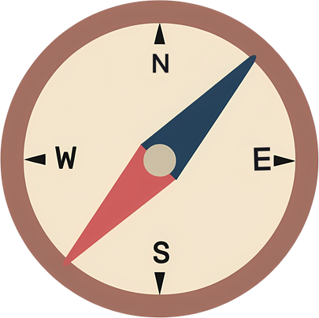
Bay Navigator badge activities
Bay Navigator
Evidence
Risk Assessment Table or Map Plot
Draw your safety map or attach risk assessment sheet
Task: Tide-Line Risk Assessment & Wayfinding
Identify a ‘working zone’ on the beach. Create a safety briefing for a younger group, identifying three specific hazards (e.g. fast-rising tides, sinking sand, weather changes). Use a compass or map to plot an emergency exit route.
Resources: Local tide tables, OS Map of Morecambe Bay, compass
Prior Learning: Understanding tide times and basic map symbols.
Essential Skills: Leadership & Problem Solving.
My Reflection
How did you ensure the safety of others?
What would you do if the weather changed and it began thundering & lightening?

Slide 6
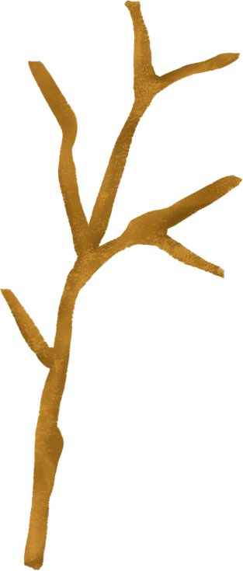
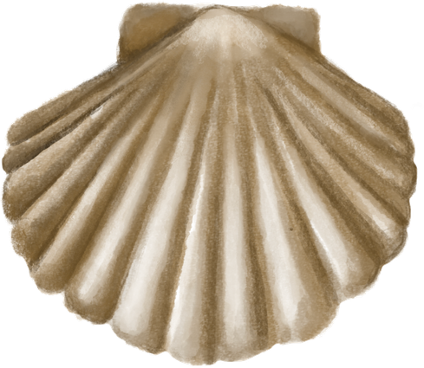
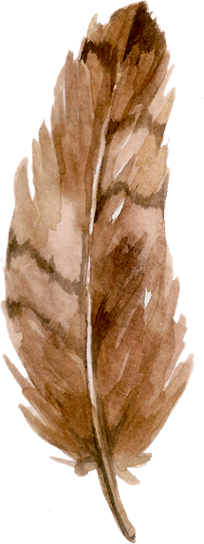
Coastal Crafter badge activities
Coastal Crafter
Evidence
Space to stick a photo (s) of your sculpture!
Level 1 task
Task: Shoreline Sculpture
Using only natural materials you find e.g. driftwood, shells, stones, leaves, feathers, twigs create a sculpture that represents a local sea creature.
Resources: natural found materials, camera for evidence.
Prior learning: Discussion on “Leave No Trace” ethics.
Essential Skills: Creativity and staying positive
My Reflection
How did you find this activity?
How did you decide what to make using what you found?

Slide 7
Coastal Crafter badge level 2 activities
Coastal Crafter
Evidence
Space to stick a photo or write a description of your beach telegraph tower
and how it worked.
Level 2 task
Task: Coastal Navigation and Signalling
Construct a functional “Beach Telegraph” system.
Build a stable driftwood or twig tower, e.g. tripod, at least
1 metre tall.
Use found reflective items or contrasting shells to create a direcional marker or SOS signal, visible from a distance.
Resources: drfitwood, twigs, fallen branches, discarded fishing line/rope, other debris, scissors, tape measure.
Prior learning: basic knot skills, health and safety knowledge of safe and unsafe items at the beach.
Essential skills: Problem solving and aiming high
My Reflection
If you could change one thing about your work, what would it be and why?

Slide 8
Coastal Communicator badge Level 1 activities
Coastal Communicator
Evidence
Share your Bay Broadcast with another group or staff member.
Ask them what they learnt from the report.
Level 1 task
Task: The Bay Broadcast
In pairs, record a 60 second weather and tide report or a tourist tip for visitors to Morecambe Bay, using either a mobile device or writing a transcript.
Resources: tablet/phone or paper and pen.
Prior Learning: Basic understanding of tide safety.
Essential Skills: Speaking and listening, teamwork.
My Reflection
What did you learn from this task?

Slide 9
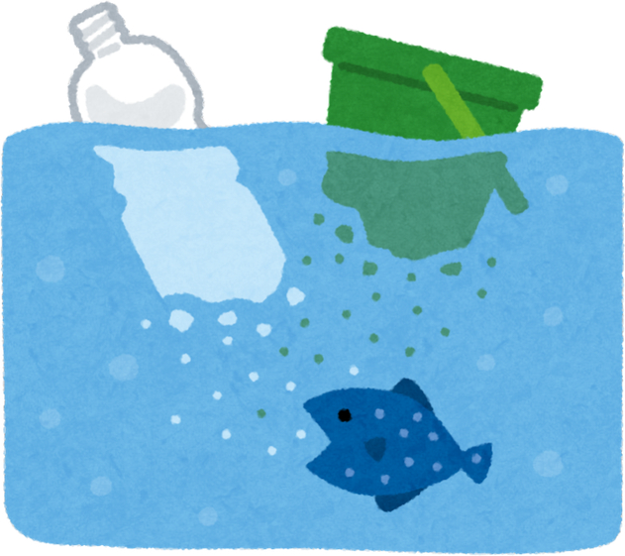
Coastal Communicator badge Level 2 activities
Coastal Communicator
Evidence
Attach a copy of your finished work here.
Level 2 task
Task: Campaign for the Coast
Create a formal pitch or digital poster for a local business on why they should reduce single-use plastics or recycle more waste - to save the Bay’s eco-system.
Resources: design software (e.g. Canva), paper, pens
Prior learning: Impact of microplastics on local biodiversity
Essential skills: leadership, creativity
My Reflection
What is one thing you learnt whilst completing this task?
Do you think you work could be shared around the Bay to encourage positive choices?

Slide 10
Bay Survival Skills Badge Level 1 activities
Bay Survival Skills
Evidence
Get a team member to record an observation log
e.g. What you did and how you did it.
Then record one for them.
Level 1 task
Task: The Shelter Race
Working as a team, identify a natural windbreak and use a tarpaulin and paracord/rope to build a “lean to” shelter that can withstand the Bay wind.
Resources: tarps, paracord/rope, pegs/heavy stones, additional natual things you find on the ground.
Prior Learning: Understanding wind direction and basic knots.
Essential Skills: Teamwork and communication.
My Reflection
Was your shelter successful?
What role did you take in the group to complete this task?

Slide 11
Bay Survival Skills badge Level 2 task
Bay Survival Skills
Evidence
Level 2 task
Task: First Aid on the Bay
Demonstrate how to signal for help using a signal mirror or whistle.
Explain the process of “cold water shock” and how to treat it in an emergency.
Resources: whistle, mirror, survival blanket
Prior Learning: First Aid basics, emergency protocols
Essential Skills: Problem solving, communication, staying positive
My Reflection

Slide 12
Coast Explorer badge Level 1 activity
Coast Explorer
Evidence
Attach a photograph or drawing of the 3 things you found.
Level 1 task
Task: Rockpool Bio-Blitz
Identify and record 3 different species found in a rockpool.
Note their physical adaptations e.g. how they stick to rocks.
Resources: ID guides, magnifying glasses, buckets (optional).
Prior Learning: Identifying common crustaceans, molluses
Essential Skills: Aiming high, observations
My Reflection
What 3 things did you identify?
1.
2.
3.

Slide 13
Coast Explorer badge Level 2 activities
Coast Explorer
Evidence
Level 2 task
Task: Human Impact Survey
Map a 50 metre area of the Morecambe Bay coast line.
Identify “Human features” vs “Physical features”.
Analyse how human activity, e.g. construction of sea walls, ramps, piers, has changed the shape of the coastline.
Resources: clipboards, or local area maps
Prior Learning: understanding coastal erossion, human-made sea defences
Essential Skills: analysis, speaking.
My Reflection

Slide 14
The Human Compass additional activity
Skills gained
Observation: noticing small details in a wide landscape.
Teamwork: relying on others’ eyes to “see” the target.
Communication: using clear, non-visual directions.
The Human Compass
The Goal: Develop 360 degree observation and precise communication without using any tools.
The Activity: In groups of 3,
One student is the lookout,
One student is the navigator,
One student is the recorder.
The lookout stands in a fixed spot and must describe a distant landmark, e.g. a building, a hill. They must only use descriptive language. No pointing!
The navigator must use the descriptive language to find the object and describe its clockface position e.g. object is at 2 o’clock.
The recorder sketches the horizon line
based only on the descriptions given by
the others.
My Reflection
How did your instructions change when your partner couldn’t see what you were seeing?

Slide 15

Chart for assessor to complete on completion of each task
Level 1 stamp
Level 2 stamp
Date completed
Bay Navigator
Coastal Crafter
Coastal Communicator
Bay Warden
Bay Survival Skills
Coast Explorer
Additional Comments from the Assessor

Slide 16
5 bonus no equipment activities
5 Bonus “No-Equipment” Activities
The Sound Map
Coast Explorer, observation)
Task: Students sit silently, 5 meters apart, for 3minutes with their eyes closed. They draw a map in the sand around them using only symbols for sounds they hear, e.g. a bird to the left, a distant car to the right, a wave in front.
Focus: sensory observation and identifying human vs natural soundscapes.
Mirror the Movement
(Coastal Communicator, teamwork)
Task: in pairs, one student performs a “slow-motion” coastal action (e.g. a crab scuttling or a wave crashing). The partner must mirror it exactly, without speaking.
Focus: Non-verbal communication and intense focus on a team mate’s cues.
Shadow Sundial
(Bay navigator, observation)
Task: Find a fixed point (e.g. a groyne or a large rock). A student marks the end of its shadow in the sand with their foot. They return 30minutes later to see where the shadow moved and predict where it will be in another hour.
Focus: Understanding the Earth’s rotation and the passage of time without using a watch.
The Shell Sorters Code
(Bay Warden, communication)
Task: One student creates a pattern using only 3 types of found natural objects e.g. a white shell, a grey pebble, a piece of green seaweed. Describe the pattern to a partner who is not looking who must recreate it perfectly.
Focus: Precise verbal instruction, listening
Human Knot: Tide Rescue
(Bay survival skills, Teamwork)
Task: A group stands in a circle and grabs the hands of 2 different people opposite them. Without letting go, they must untie the know to form a perfect circle before an imaginary tide comes in.
Focus: Group problem-solving and leadership under pressure.

