Slide 1

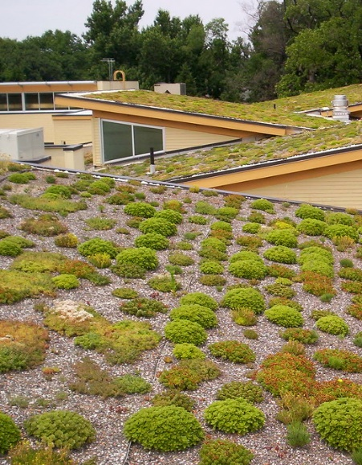
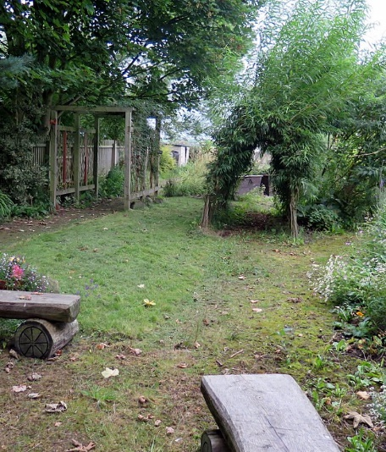
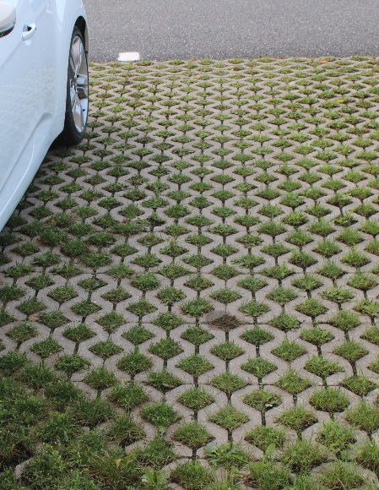
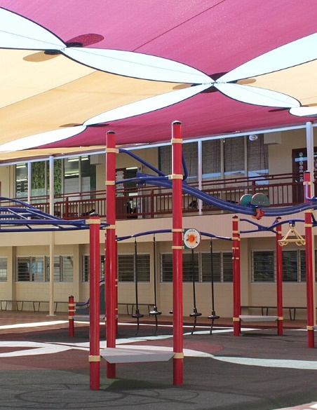
Use of groundcover and shrubbery
Green roofs
Improve the infiltration of rainwater to the subsurface, reducing the chance of flooding. May also cool the environment through evapotranspiration and by providing shade. May also improve air quality.
Cost: £-££
Co-benefits: ++
A roof that is partially or completely covered with vegetation and a growing medium, over a waterproofing membrane. Green roofs help store rainwater and prevent rapid entry of water to the drainage system. Also help lower air temperatures.
Cost: ££
Co-benefits: +
Permeable paving
Outdoor shading systems
A range of sustainable materials and techniques with a base and sub-base that allow water to pass through the surface.
Cost: ££
Customisable shelter providing shade.
Cost: £-££
Notes:
Images
Groundcover shrubbery: https://www.geograph.org.uk/photo/4624333
Green roof: https://www.flickr.com/photos/arlingtonva/3926468274
Permeable paving: https://commons.wikimedia.org/wiki/File:Pav%C3%A9_alv%C3%A9ol%C3%A9.jpg
Outdoor shading: https://commons.wikimedia.org/wiki/File:Townview_State_School_school_buildings_with_shade_sails,_2017.jpg

Slide 2
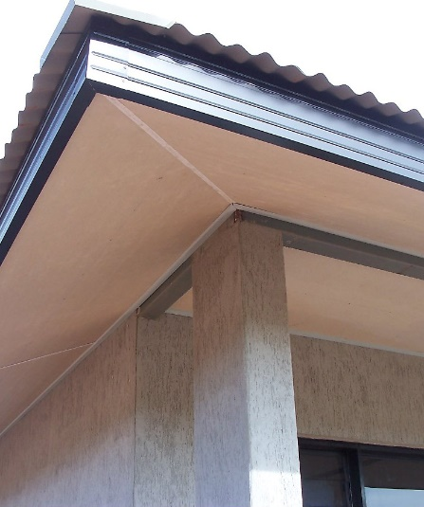
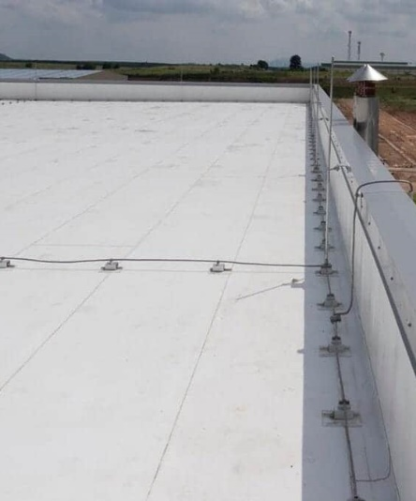


Roof overhang / extended eaves
Cool / reflective roofs
Reflective surfaces can deliver high solar reflectance and reduce heat transfer to the surface. May reduce air conditioning costs.
Cost: £££
Co-benefits: +
Enlarging roof eaves can create shade and mitigate the effects of heat stress in summer and let in sunlight in winter.
Cost: £££
Interior blinds
Use of cool spaces
Blinds may be used in buildings to block sunlight entering through windows.
Cost: £
Avoid using south facing rooms when hot to reduce exposure to effects of sunlight coming through the windows.
Cost: 0
Notes:
Images
Roof eaves: https://commons.wikimedia.org/wiki/File:Eaves-lining.jpg
Reflective roof: https://allweatherroof.com/essential-considerations-for-selecting-pvc-and-pvc-kee-roofing-in-commercial-applications/
Interior blinds: https://www.hippopx.com/en/free-photo-zixnk

Slide 3
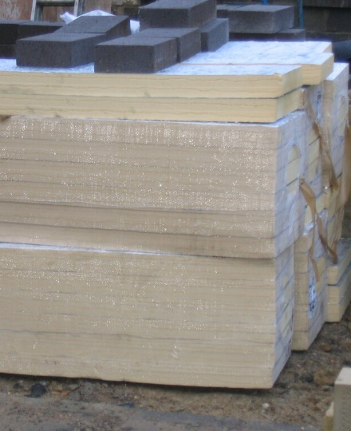
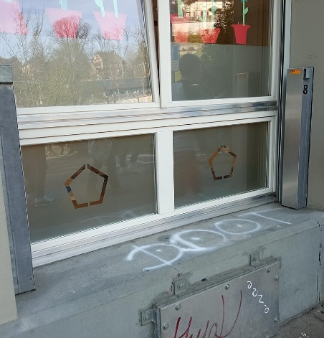
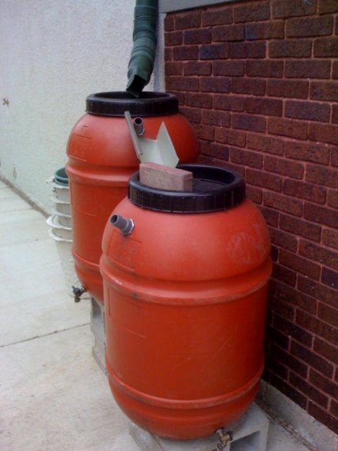
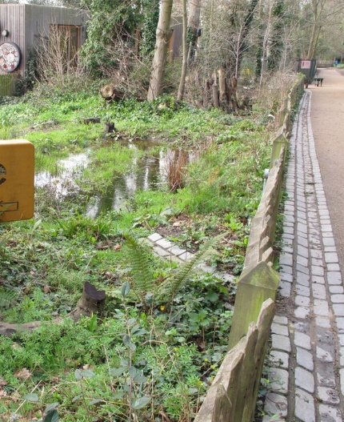
Thermal insulation
Sealable buildings
Thermal insulation of facades and roofs reduces the temperature rise during hot days. The climate inside the building will remain cooler and air conditioning demand reduced. During winter heat is retained, reducing energy consumption.
Cost: ££-£££
Co-benefits: +
The exterior of buildings can be made waterproof to prevent flood water entering the building e.g. with flood barriers.
Cost: £-££
Rainwater tanks
Sustainable drainage systems
A rainwater tank or water butt is used to collect and store rainwater runoff. Stored water may be used for watering plants, flushing toilets, or washing vehicles during dry periods.
Cost: £-££
Creating green spaces for water storage helps reduce flood risk during extreme rainfall. They also provide opportunities for biodiversity.
Cost: ££-£££
Co-benefits: +
Notes:
Images
Rainwater tank: https://www.flickr.com/photos/mjmonty/2521497598
Sustainable drainage: https://www.geograph.org.uk/photo/6403851
Insulation: https://openverse.org/image/a60b3dc2-b7f0-41ef-8144-7571b0b0647d?q=insulation&p=3
Sealable building: https://commons.wikimedia.org/wiki/File:Rails_for_flood_barriers_to_protect_a_window_from_flooding.jpg

Slide 4




Register for flood alerts
Subscribe to heat health alerts
Register for flood alerts from the Environment Agency or weather warnings from the Met Office.
Cost: 0
The Heat-health alert service is provided by the UK Health Security Agency in partnership with the Met Office from June - Sept. Individuals and organisations can sign up to help through periods of extreme temperature.
Cost: 0
Adapt rules / behaviours
Adapt lessons
For example, amend or relax school dress code during hot spells.
Cost: 0
For example, have less vigorous PE lessons or activities on very hot days.
Cost: 0
Notes:
Images
Adapt rules & behaviours: https://commons.wikimedia.org/wiki/File:School_girls_in_Bhaktapur.jpg
Adapt lessons: https://commons.wikimedia.org/wiki/File:Fairfax_County_School_sports_-_08.JPG
UKHSA: https://www.gov.uk/government/organisations/uk-health-security-agency
Flood alerts: https://www.befloodready.uk/during-a-flood/what-you-should-do

Slide 5
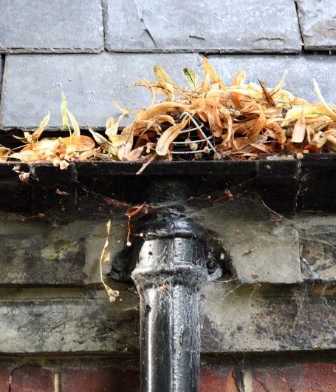



Switch off electrical appliances
Increase infrastructure maintenance
Switching off unused appliances can reduce heat generation and help keep workplaces cool. This can also reduce energy bills and carbon emissions.
Cost: 0
Co-benefits: +
Reviewing and upgrading the maintenance regime of e.g. roofs, gutters, drains and below ground drainage infrastructure can increase resilience to extreme weather.
Cost: £
Communication and education of risks
Seek advice
Increasing awareness through better communication and education of risks and responsibilities to staff and students can help reduce impacts of extreme weather.
Cost: 0
The Climate Ambassadors scheme provides education settings with access to a network of volunteers to provide you with free, personalised support for your climate action plans.
Cost: 0
Co-benefits: ++
Notes:
Images
Switch off electrical appliance: http://www.freeimageslive.co.uk/files/images008/power_switch.jpg
Blocked gutter: https://www.flickr.com/photos/49968232@N00/43343970
Communication & Education: https://www.ukclimaterisk.org/publications/factsheet-for-children-young-people/#section-1-climate-change-adaptation
Climate Ambassadors: https://climateambassadors.org.uk/

Slide 6
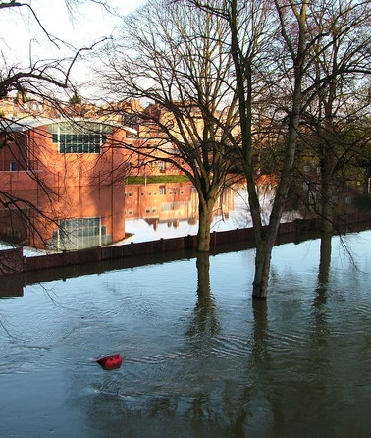



Review flood insurance
Drought-resistant gardens
Reviewing flood policies to ensure they are up to date to cover risks. Implementing flood management measures may reduce premiums.
Cost: 0
Where green spaces exist or green adaptation measures like rain gardens are implemented, identify appropriate plant species where drought may be a risk.
Cost: £-££
Emergency generators
Engage with local community and stakeholders
Power generators provide a backup for the power supply in case of flood events to ensure vital systems can remain operational.
Cost: £
Talk to relevant local authority departments (e.g. planning, highways), or adjacent landowners about joint solutions. This may result in reducing surface water flood risk in the local area, not just for the setting.
Cost: 0
Notes:
Images:
Drought resistant gardens: https://www.flickr.com/photos/ukgardenphotos/13545736913
Emergency generator: https://sanbornsac.com/electrical/backup-generators/maintenance/
Flood insurance: https://commons.wikimedia.org/wiki/File:Looking_across_the_flooded_Severn_from_the_back_of_Shrewsbury_School_Chapel_-_geograph.org.uk_-_1478677.jpg
Engagement: https://commons.wikimedia.org/wiki/File:Network_%2822612%29_-_The_Noun_Project_-_black.svg

